Slide 1
Briefing for “Find available slot” feature

Slide 2
Required Features
What to show on Search settings screen
5 options for “Search time between”
Pull-down box for “From” and “To” (both to be grayed-out before the “Customized Search is selected)
5 options for “Search dates between”
Pull-down box for “From” and “To” (both to be grayed-out before the “Customized Search is selected)
Pull-down list for “Length of meeting required”
Pull-down list for “Buffer between existing meetings”
Checkbox for “Don’t include public holidays”
Checkbox for “Don’t include All-Day events”
Close button
Search button
What to show on Results screen
List of all available time slots based on user’s Google calendar’s availability (matching the conditions set above)
Close button

Slide 3
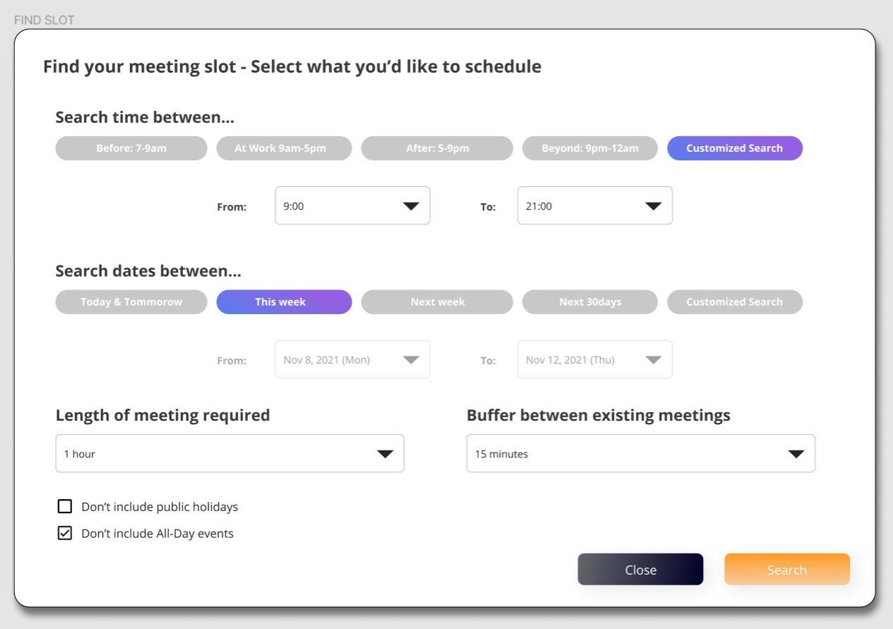
Screen for “Find Slot” assumption settings – WHAT EACH ELEMENT MEANS
What this means
“Search for slots between 9:00 – 21:00 (9pm)”
What this means
“Search for slots this week (from Mon to Fri)”
What this means
“Search for slots that we’re available for 1 hour”
What this means
“For all existing meetings, assume that 15 minutes before/after each meeting should not be included as available slots” FYI – if you have meeting from 9-10am, you’re availability should be calculated as “Before 8:45am” and “After 10:15am”
What this means
“Please do not include public holiday in results”
“Please ignore the all-day events scheduled when searching for slots”

Slide 4
Screen for “Find Slot” assumption settings – WHAT USERS CAN DO
User can select from the 5 options (can select multiple items except “Customized Search”
The 2 pull-down items should be grayed-out at the beginning, but appear when “Customized Search is selected
User can select from the 5 options (can select multiple items except “Customized Search”)
The 2 pull-down items should be grayed-out at the beginning, but appear when “Customized Search is selected
Set length of time slot we’re searching for
Should be a pull-down list including;
5 min /10min / 15 min / 30 min / 1 hour [preset to be shown] / 1.5 hours / 2 hours / 3 hours / 4 hours / 5 hours / 6 hours / 7 hours / 8 hours
Set length of time buffer we’d like to keep before/after existing meetings
Should be a pull-down list including;
No Gap / 5min / 10 min / 15 min [preset to be shown] / 30 min / 60 min
Close to return to previous screen
Search and show available slots (next page)
Consider these conditions when filtering the search results

Slide 5
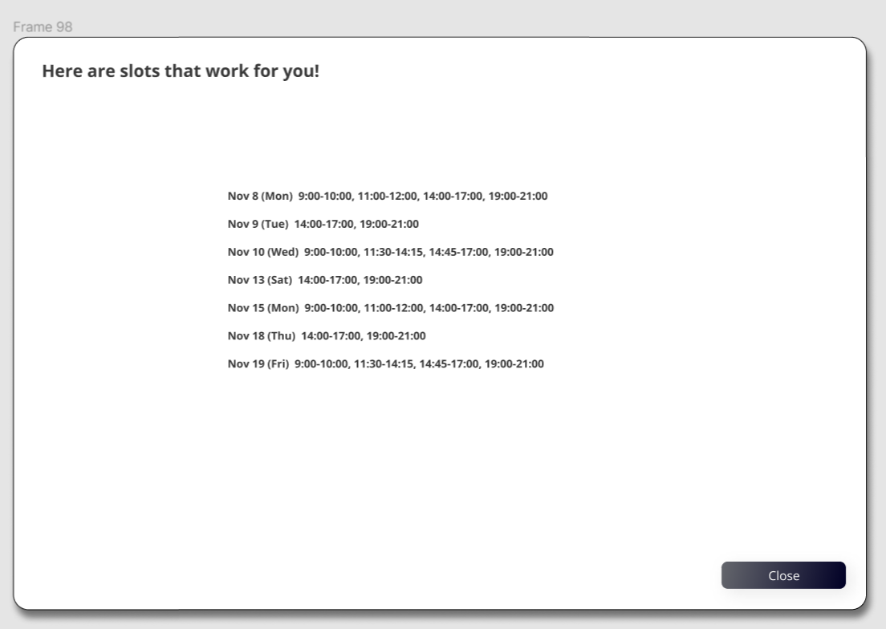
Results from the FIND SLOT calculation
Output can be a simple list on the screen – we plan to use this data for another additional feature
(so as long as we can confirm and copy the results, it’s fine)

Slide 6
Reference) Expected DB table for Public Holidays

